Slide 1

CAPSTONE PROJECT ON EDA Hotel Bookings Analysis
By:- Purushotam

Slide 2
Problem Statements
For this project we will analyzing hotel booking data.
This data contains booking information for a city hotel and resort hotel and includes information such as when the booking was made length of the stay the number of adults children's and or babies and the number of available parking spaces.
Hotel industry is a very volatile industry and the bookings depend on our factors and many more the main objective behind this project the bookings and give insights to hotel management on which they can perform various campaigns to boost their performance of business.

Slide 3
Workflows
We have divided the data into three parts
Data collection :-
Dataset has been provided by the Alma Better https://grow.almabetter.com/data-science/projects/Hotel-Booking-Analysis
Data loading:-
Dataset was loaded on google drive was loaded on goggle colab('/content/drive/MyDrive/ColabNotebooks/datasets/Hotel Bookings.csv’)
Data Cleaning and manipulation:- For data cleaning numpy, pandas, and matplotlib is used
Removing the duplicates:- Analysing the data we found out of 119390 rows 31994 rows are duplicates so we removed them.
Removing the company column with most nan values:- Analysing the company column we found it has only 5259 values are not nan remaining does not provide any significant data . So we deleted the column.
Beginning with EDA :-

Slide 4
Data Description:
hotel : Hotel(Resort Hotel or City Hotel)
is_canceled : Value indicating if the booking was cancelled (1) or not (0)
lead_time: Number of days that elapsed between the entering date of the booking into the PMS and the arrival
datearrival_date_year : Year of arrival
datearrival_date_month : Month of arrival
datearrival_date_week_number : Week number of year for arrival
datearrival_date_day_of_month : Day of arrival
datestays_in_weekend_nights : Number of weekend nights (Saturday or Sunday) the guest stayed or booked to stay at the
hotelstays_in_week_nights : Number of week nights (Monday to Friday) the guest stayed or booked to stay at the hotel
adults: Number of adults
children: Number of children
babies: Number of babies
meal: Type of meal booked. Categories are presented in standard hospitality meal packages:
country: Country of origin.
market_segment : Market segment designation. In categories, the term “TA” means “Travel Agents” and “TO” means “Tour Operators”
distribution_channel : Booking distribution channel. The term “TA” means “Travel Agents” and “TO” means “Tour Operators”
is_repeated_guest : Value indicating if the booking name was from a repeated guest (1) or not (0)

Slide 5
previous_cancellations : Number of previous bookings that were cancelled by the customer prior to the current booking*
previous_bookings_not_canceled : Number of previous bookings not cancelled by the customer prior to the current
bookingreserved_room_type : Code of room type reserved. Code is presented instead of designation for anonymity reasons.
Assigned_room_type : Code for the type of room assigned to the booking.
booking_changes : Number of changes/amendments made to the booking from the moment the booking was entered on the PMS until the moment of check-in or cancellation
deposit_type : Indication on if the customer made a deposit to guarantee the booking.
agent : ID of the travel agency that made the booking
company : ID of the company/entity that made the booking or responsible for paying the booking.
days_in_waiting_list : Number of days the booking was in the waiting list before it was confirmed to the
customercustomer_type : Type of booking, assuming one of four categories
adr : Average Daily Rate as defined by dividing the sum of all lodging transactions by the total number of staying nights
required_car_parking_spaces : Number of car parking spaces required by the customer
total_of_special_requests: Number of special requests made by the customer (e.g. twin bed or high floor)
reservation_status : Reservation last status, assuming one of three categories
Canceled – booking was cancelled by the customer Check-Out – customer has checked in but already departed No-Show – customer did not check-in and did inform the hotel of the reason why
reservation_status_date : Date at which the last status was set. This variable can be used in conjunction with the Reservation Status to understand when was the booking cancelled or when did the customer checked-out of the hotel

Slide 6
Question 9.Which are the top five agents for city hotel?
For EDA analysis we were solving these problem statements
Question 1. Which customer type preferred the most resort hotel?
Question 2. Which type of hotel refunded the most?
Question 3. Which distribution channel is mostly used for booking City hotel?
Question 4. Which type of hotel is preferred by customer having children?
Question 5. Which type of hotel is most preferred for weekend night?
Question 6. Which year has highest booking and cancellation based on market segment (complementary)?
Question 7. preferred food by customer based on top 5 country?
Question 8. Most favorable month for booking :-
Question 9.Which are the top five agents for city hotel?
Question 10. Hotel data based on month where repeated guest is 1:

Slide 7
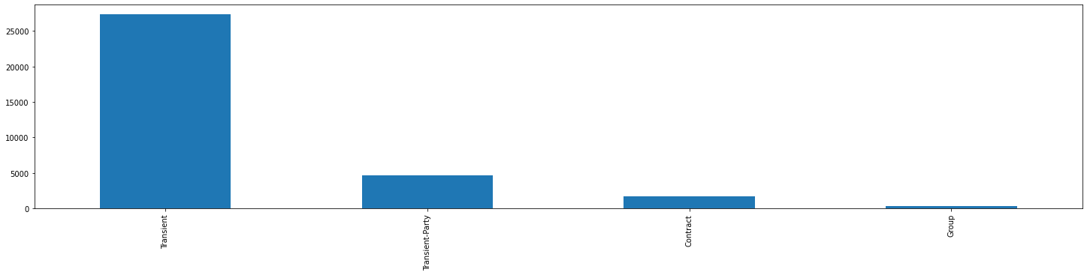
Question 1. Which customer type preffered the most resort hotel?
Transient 27345 Transient-Party 4682 Contract 1668 Group 273

Slide 8
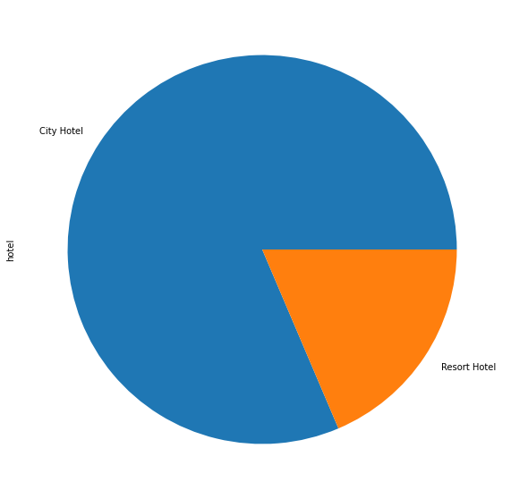
Question 2. Which type of hotel refunded the most?
City Hotel 845 Resort Hotel 193
This graph shows that city hotel has non refunded the most 845 compared to Resort Hotel 193

Slide 9
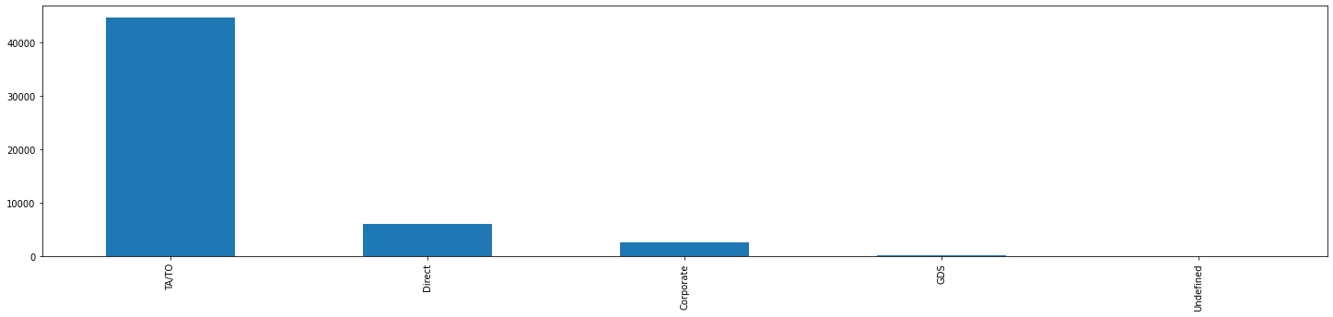
Question 3. Which distribution channel is mostly used for booking City hotel?
TA/TO 44549 Direct 6087 Corporate 2607 GDS 181 Undefined 4
This bar graph shows that TA/TO is most preferred for City Hotel 44549

Slide 10
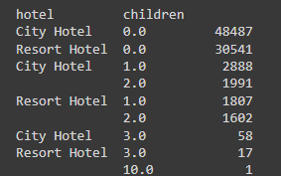
Question 4. Which type of hotel is preferred by customer having children?

Slide 11
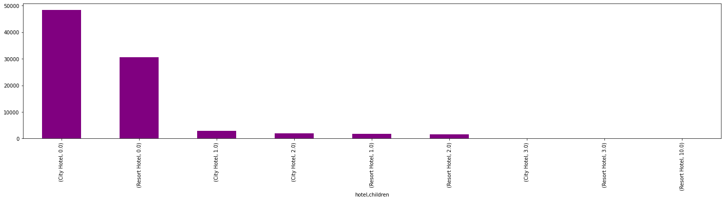
City hotel is more preferred by customers having children with age group as per dataset

Slide 12
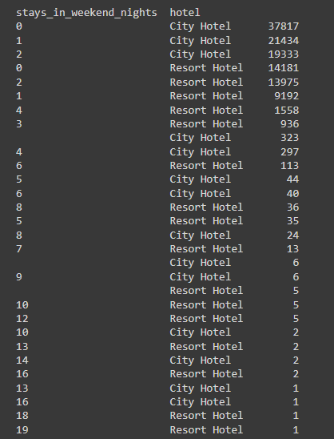
Question 5. Which type of hotel is most preferred for weekend night?

Slide 13
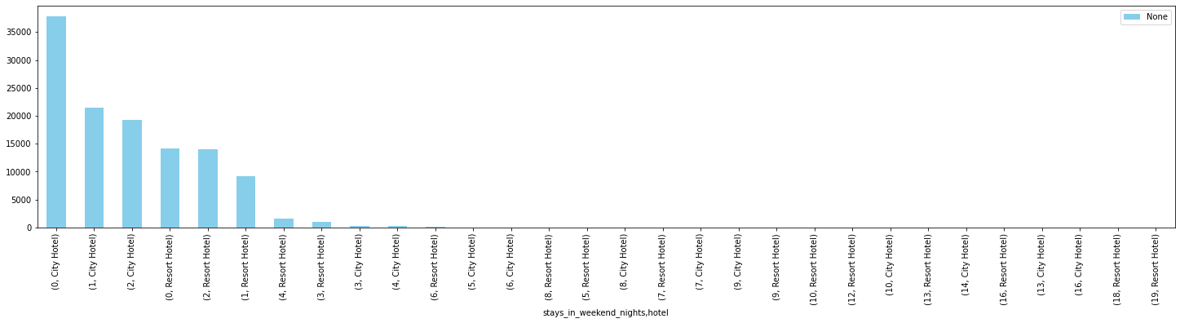
This Graph shows that city hotel is most preferred for weekend nights

Slide 14
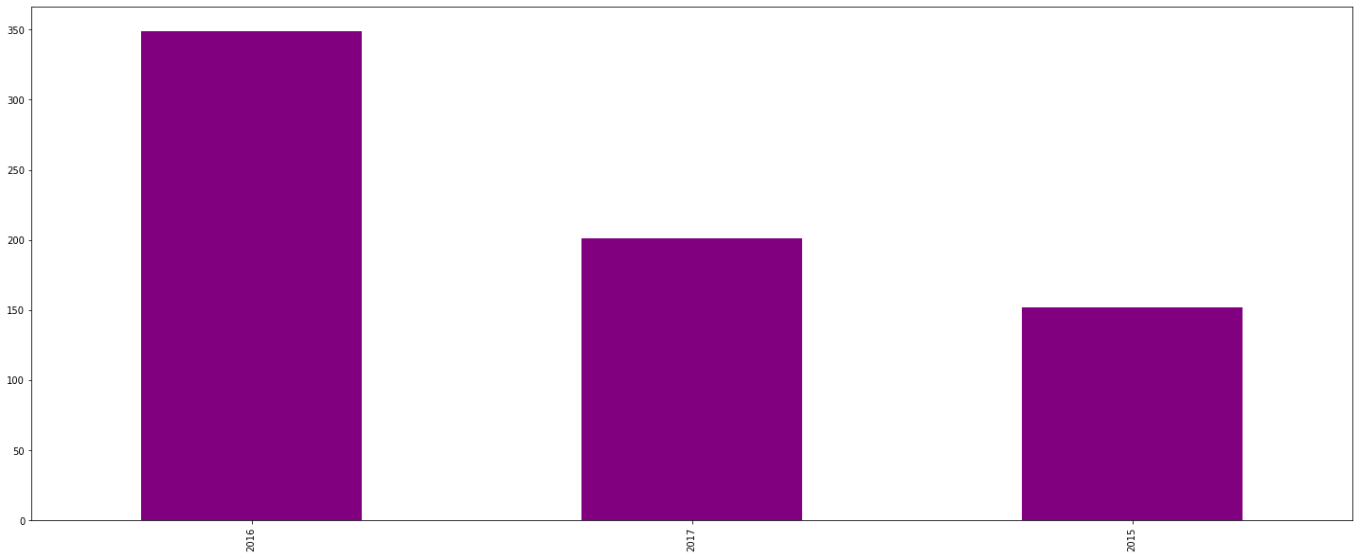
Question 6. Which year has highest booking and cancellation based on market segment (complementry)?
2015 152
2016 349
2017 201
This Graph shows the out of 2015, 2016, 2017 2016 has the highest booking and cancellation based on complimentary

Slide 15
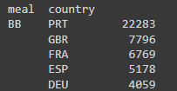
Question 7. preferred food by customer based on top 5 country?

Slide 16
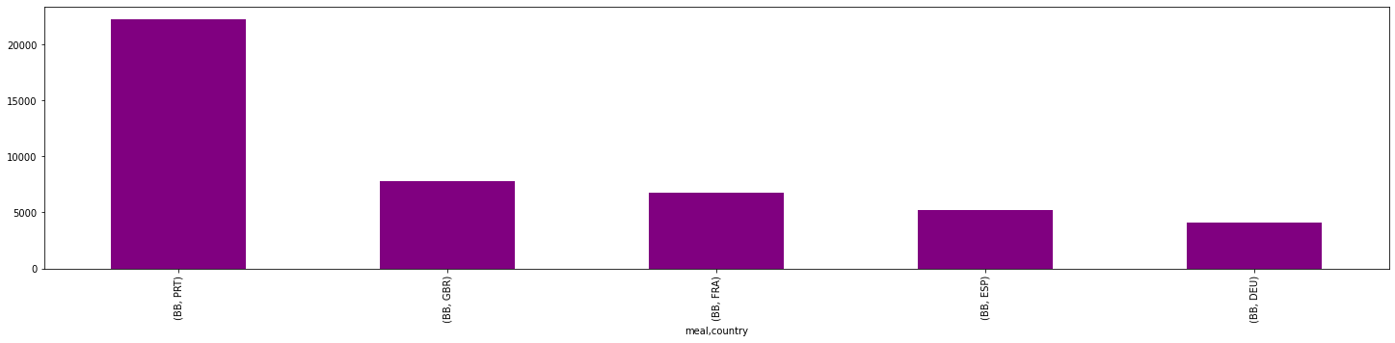
The graph shows BB is most preferred by the portugal

Slide 17
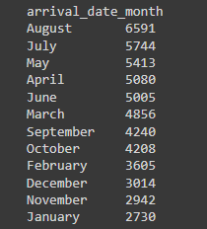
Question 8. Most favourable month for booking :-

Slide 18
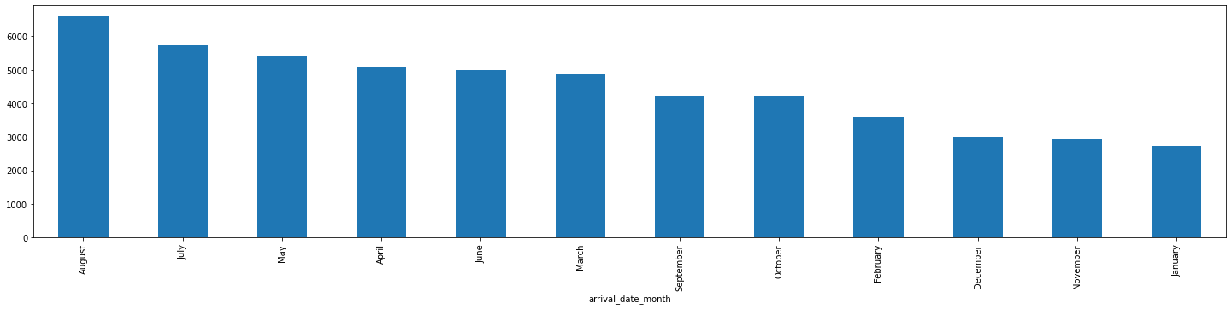
This graph shows relation between booking and months so august month is most preferred for the booking

Slide 19

Question 9.Which are the top five agents for city hotel?

Slide 20
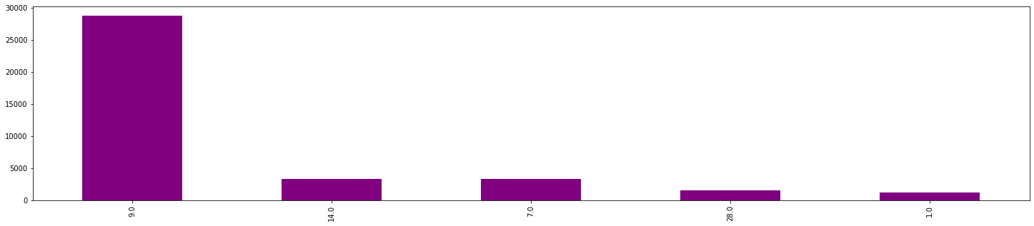
This graph shows the top five agents for the City Hotel

Slide 21
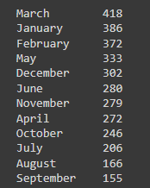
Question 10. Hotel data based on month where repeated guest is 1:

Slide 22
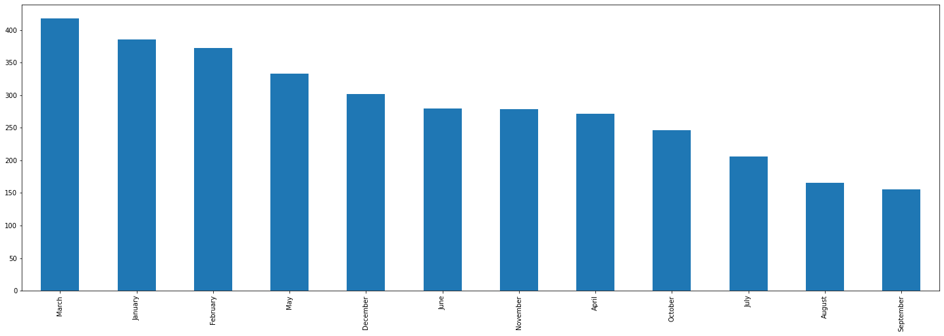
This graph shows the relation between month and Repeated Guests 1 So March has the most Repeated guest

Slide 23
Conclusion:-
Transient types of customer visited to Resort Hotel most.
City hotel has non refunded the most 845 compared to Resort Hotel having 193.
TA/TO is most preferred for City Hotel 44549.
City hotel is more preferred by customers having children with age group as per dataset.
City hotel is most preferred for weekend nights.
The out of 2015, 2016, 2017 2016 has the highest booking and cancellation based on complimentary
BB is most preferred by the portugal
August month is most preferred for the booking
9.0 is among the top five agents for the City Hotel
So March has the most Repeated guest 418

Slide 24
Thank you

